Slide 1
Inverse Kinematics and Particles
Grant Smith 40111906
Physics-based Animation

Slide 2
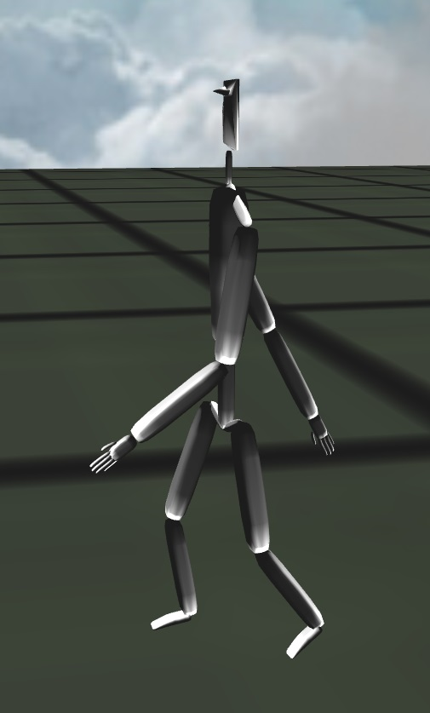
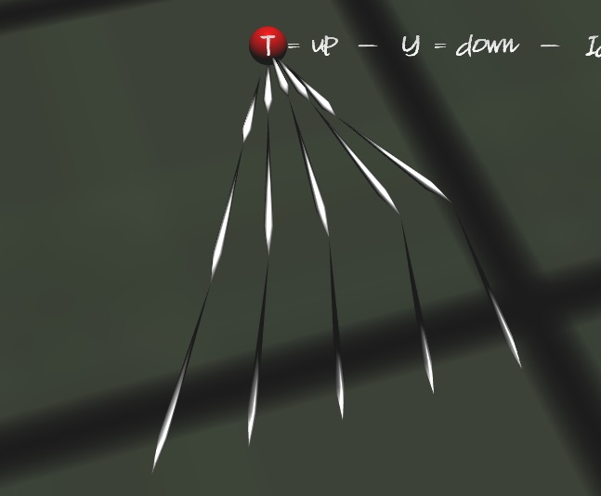
Inverse Kinematics
Implemented using the CCD method
Angle Limits
Reach Limits
Procedural Animation

Slide 3
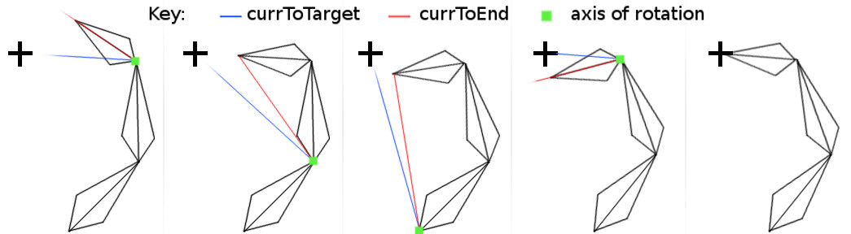
Cyclic Coordinate Descent (CCD)
Simple
Fast
Iterative
Process:
Get the axis of rotation (cross product)
Get the angle to rotate (acos + dot product)
Create a quaternion from the axis and angle
If the quaternion is within the angle limits
Rotate the link
After this is done for each link, apply the rotation from the root link down to the last child

Slide 4
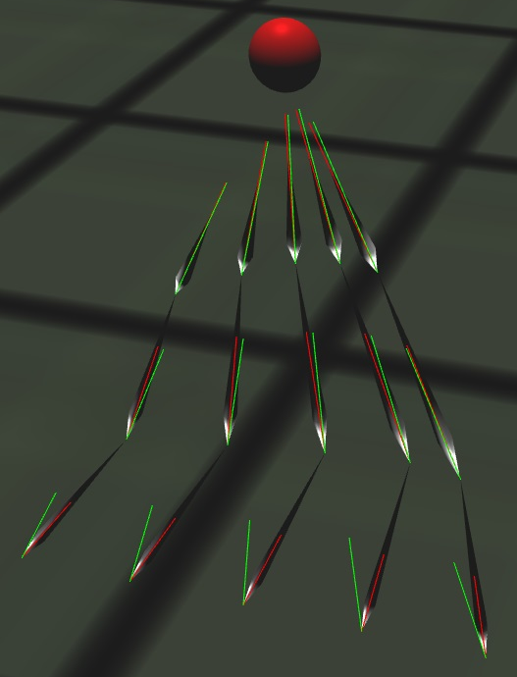
Inverse Kinematics Testing
To test the Inverse Kinematics:
Create a point to follow
Rotate that point randomly around every axis (x, y, z)
If it can reach
It should always work
If it can’t reach
It doesn’t work

